Slide 1

Computer Engineering Department A.P. Shah Institute of Technology G.B.Road,Kasarvadavli, Thane(W), Mumbai-400615 UNIVERSITY OF MUMBAI Academic Year 2021-2022

Slide 2
Synopsis on Billing and Inventory Management System Submitted in partial fulfillment of the degree of Bachelor of Engineering(Sem-4) in Computer Engineering By
Megha Soni Vandan Savla
Himali Suroshi
Niraj Patil Under the Guidance of Prof. Sukhada Aloni

Slide 3
1.1 Problem Definition
“In smaller businesses, books are utilized to keep track of records, and customers are given handwritten bills. High Tech POS is expensive and not feasible for them. There is a need for a product that is affordable and organizes the business.”

Slide 4
1.2 Objectives
This project will bridge the gap between the two existing systems.
This will simplify record-keeping and assist the organization in becoming more standardized.
Redundancy and inconsistency in data are reduced through a simpler Inventory system that works in sync with the billing system.
A digitized bill from a small firm will also provide a better experience for the customer.

Slide 5
1.3 Abstract
The main purpose of this billing system is to fulfill the requirements and to provide a more affordable and user-friendly billing system to small or local businesses.
The main goal of this system is to maintain all information about stocks and to create client bills in pdf format that may be printed and delivered to the customer and will have a pictorial representation of the sales made and inventory and the system will generate weekly or monthly reports based on the stock sold and purchased.

Slide 6
1.4 Scope
Easy to Use Billing System
Inventory System Based on Database
Generation of Stock Report and Sales Report

Slide 7
1.5 Existing System/project
Problems faced in Existing System:
Registers require space
There is no proper management of inventory
Retrieving information is difficult
Difficult to modify existing records
Inconsistency of data is obvious
There is no type of security.

Slide 8
2 Technology stack
The technology used in this project will be:
Language: Java is a programming language and a platform.
Frontend: Swing by Java and AWT by Java
Backend: Database: MySql by Oracle.

Slide 9
3.1 Benefits for Society
Helps the local business to grow.
Helps to promote more of local business.
Creates a sense of belief and builds satisfaction among the customers.
Transparency in transactions.

Slide 10
3.2 Applications
We can use this application:
Dairy
Canteen
Grocery
Local stores
Stationary

Slide 11
3.3 Future Scope
There are certain things for future enhancements in this project such as:
Mobile application can be developed which will be more helpful in terms of space and maintenance and billing purposes.
Detailed graphs for sales reports can be shown so it will be easy for users to understand their sales on a monthly or weekly basis

Slide 12
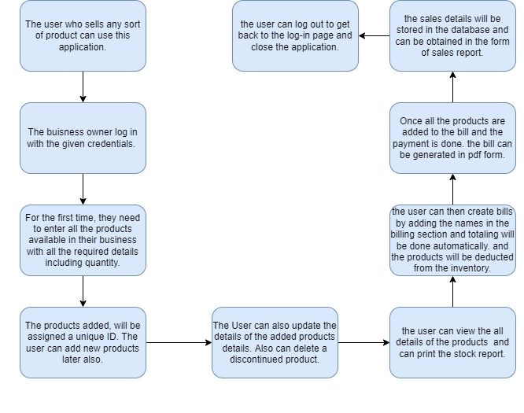
4.1 Block Diagram
Fig 4.1: Block Diagram

Slide 13
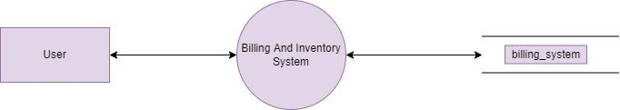
4.2.1 Level 0 Data Flow Diagram
Fig 4.2:Level 0 Data Flow Diagram

Slide 14
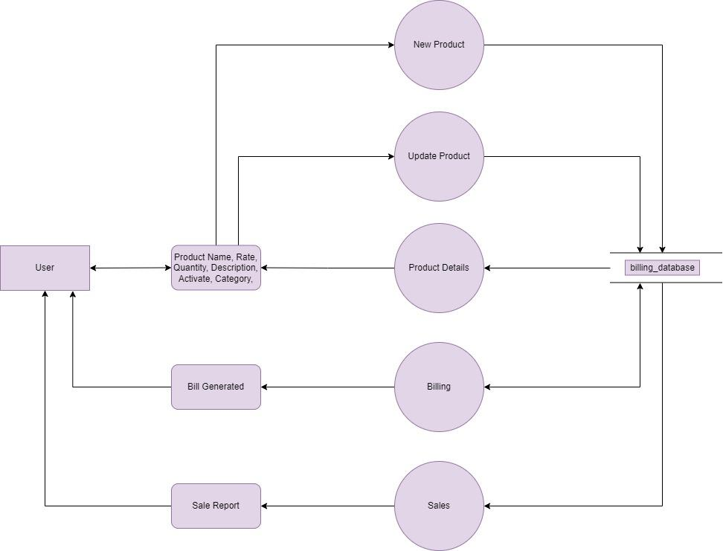
4.2.2 Level 1 Data Flow Diagram
Fig 4.3:Level 1 Data Flow Diagram

Slide 15
4.3 Project Snapshots

Slide 16
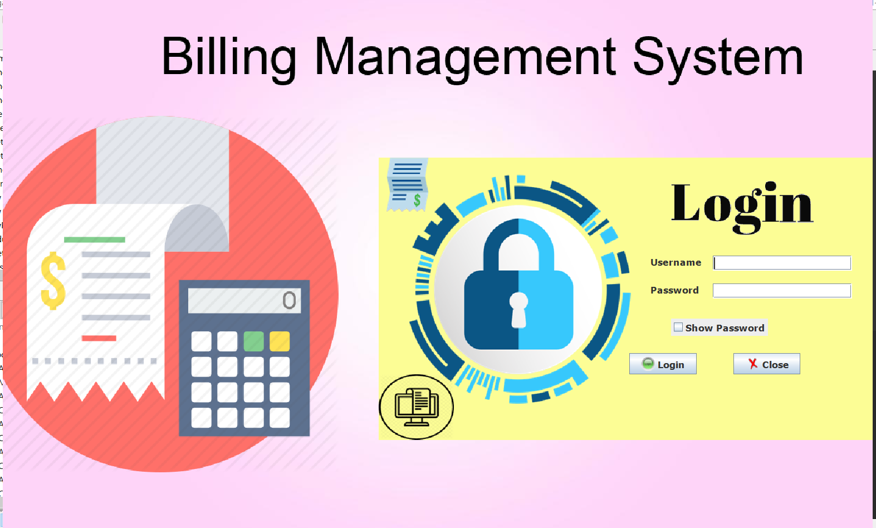

Slide 17
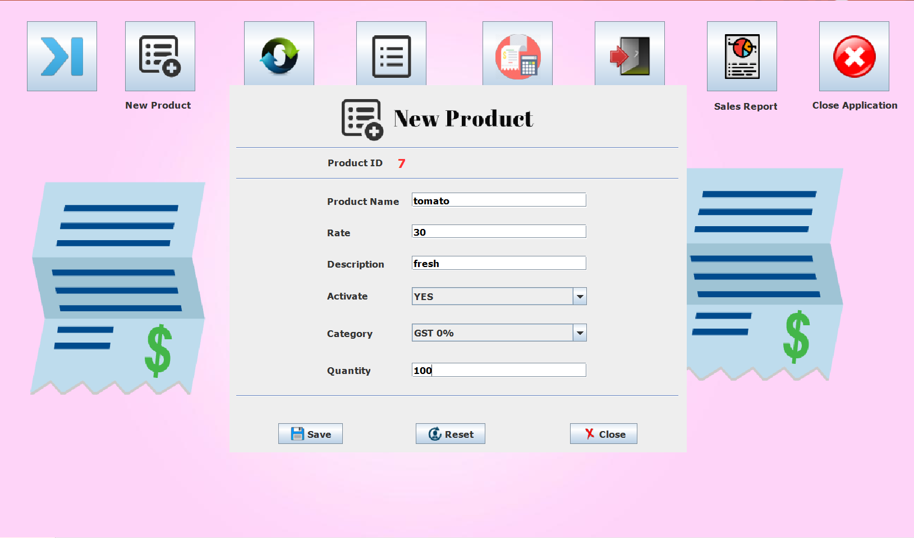

Slide 18
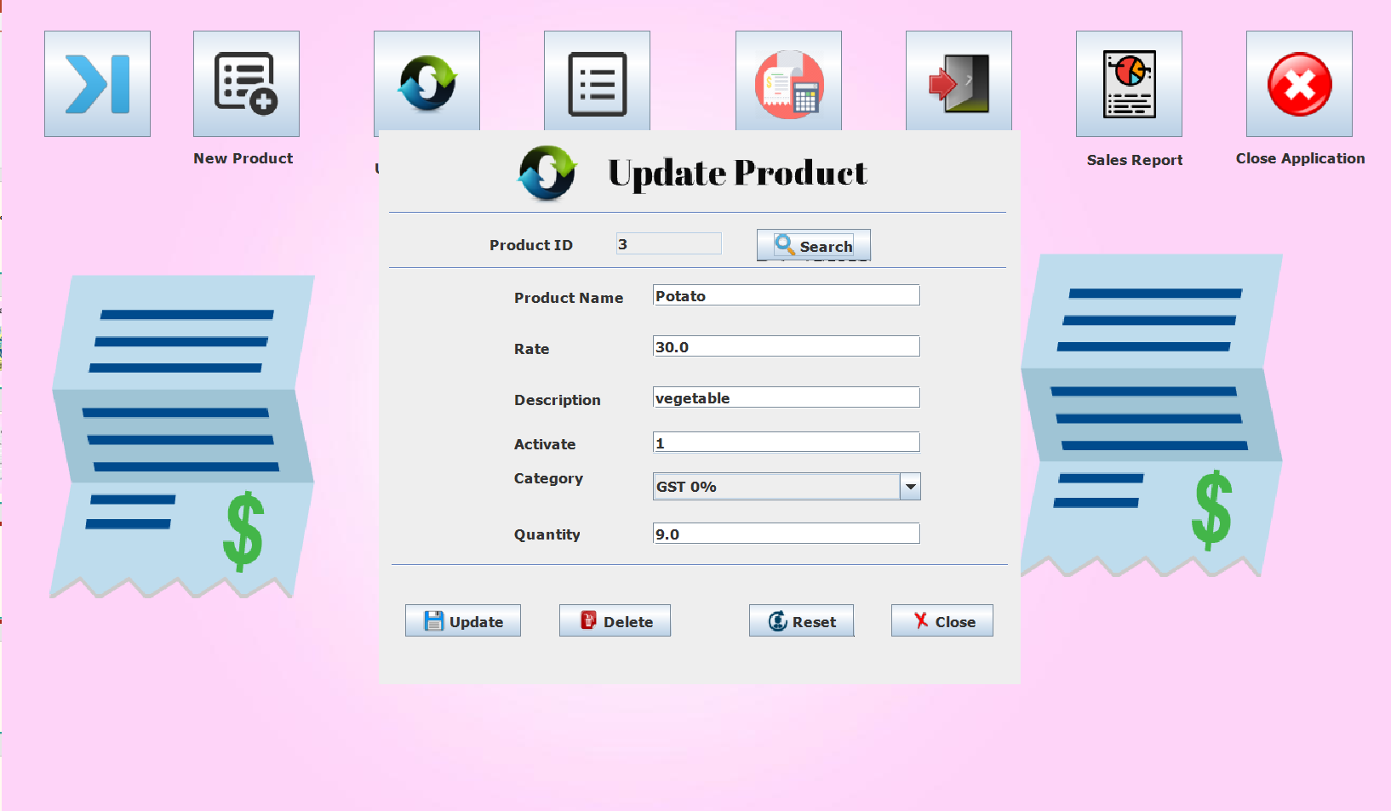

Slide 19
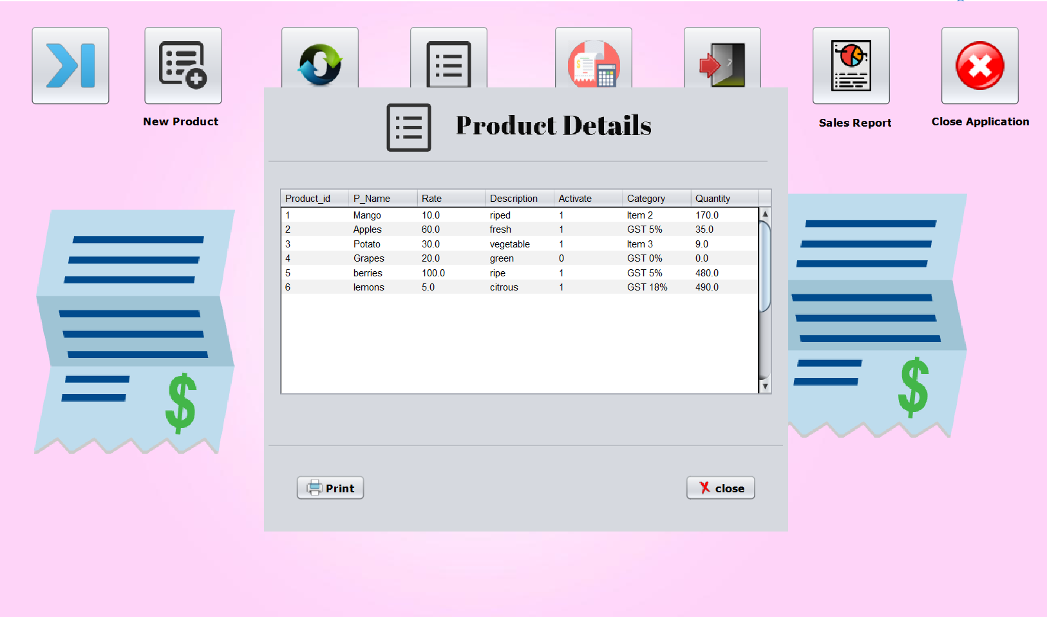

Slide 20
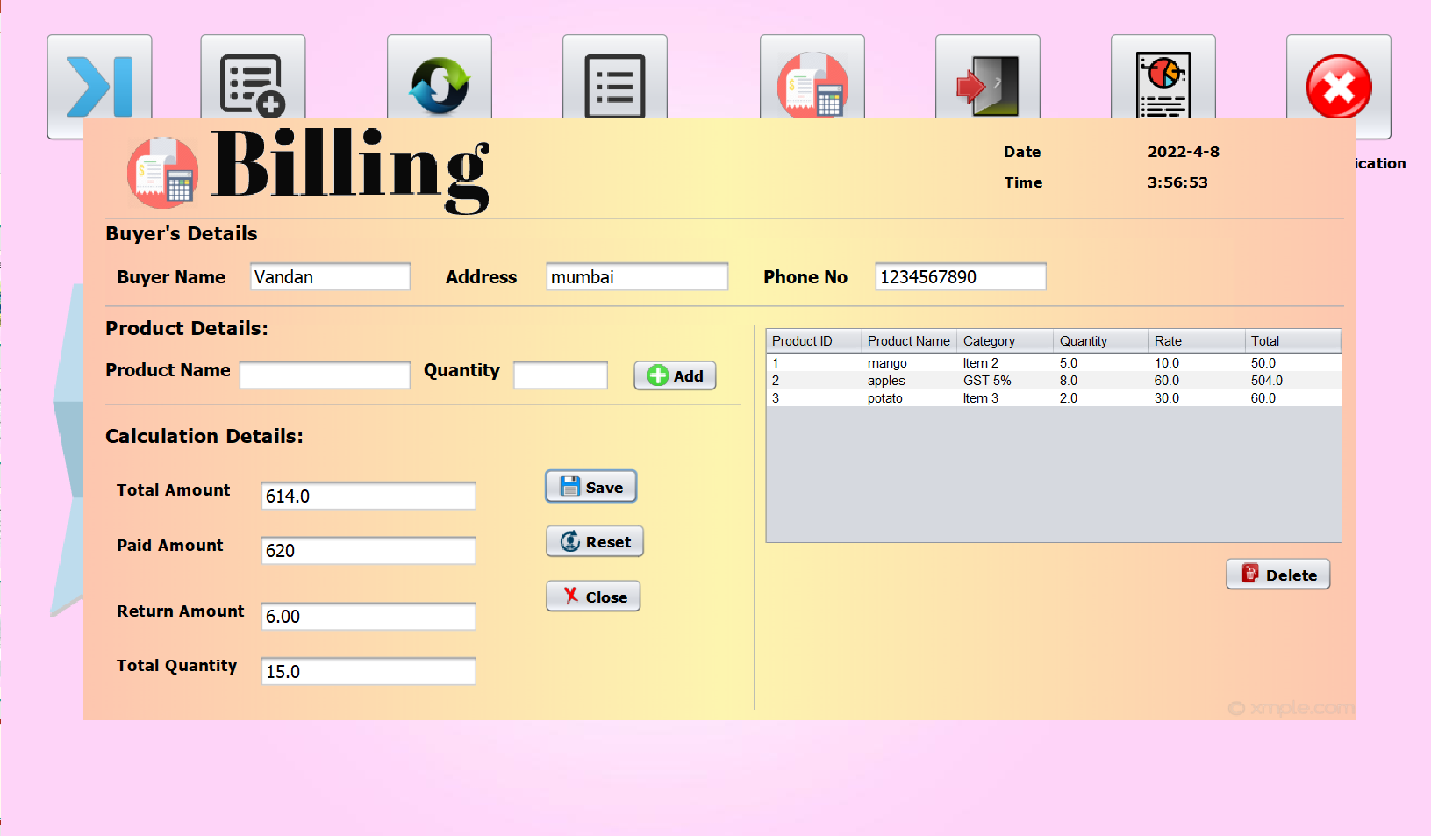

Slide 21
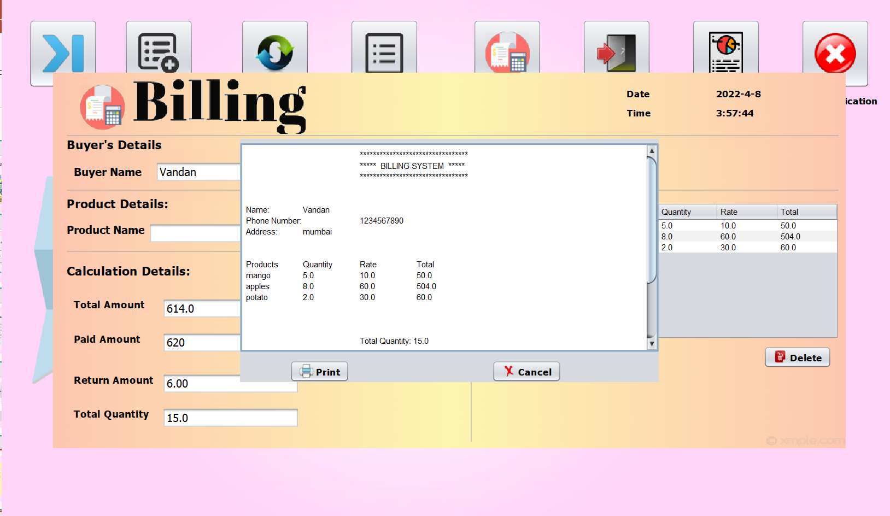

Slide 22
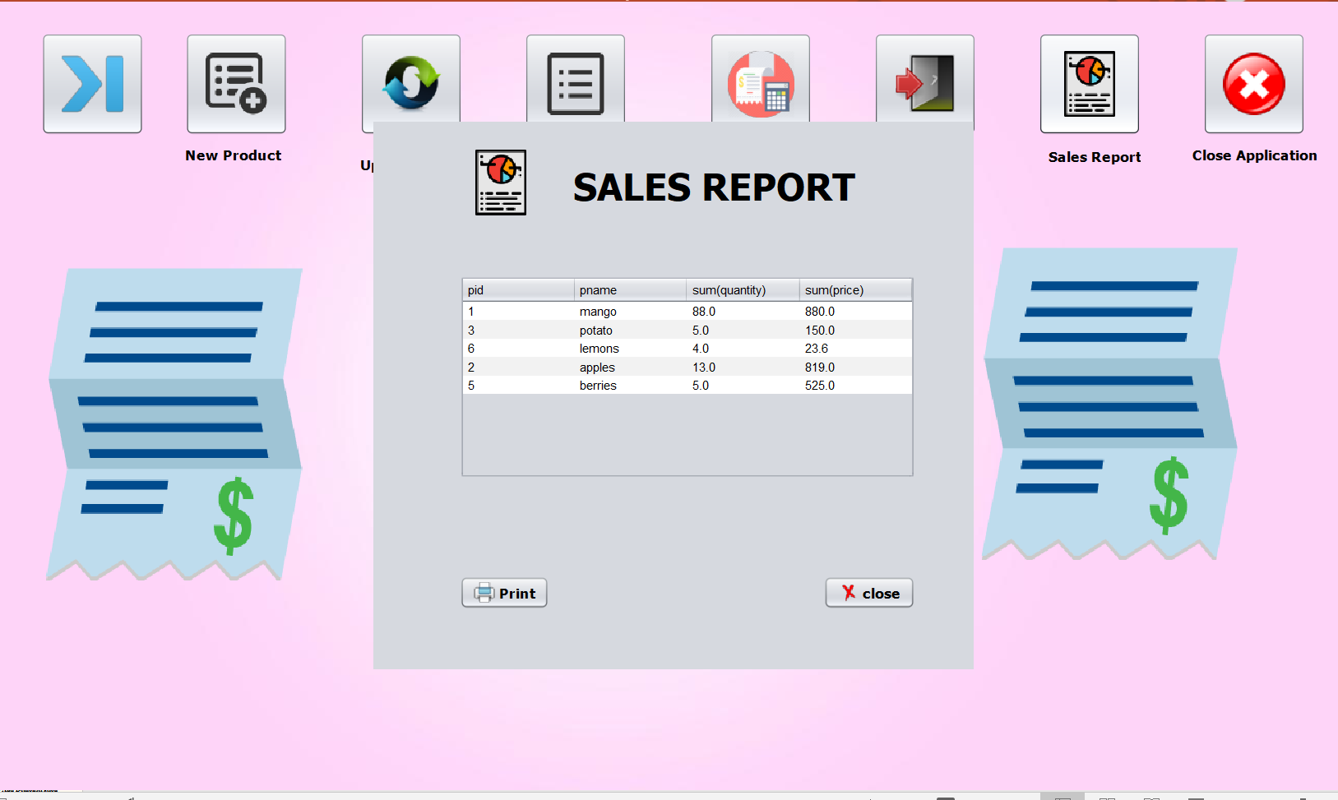
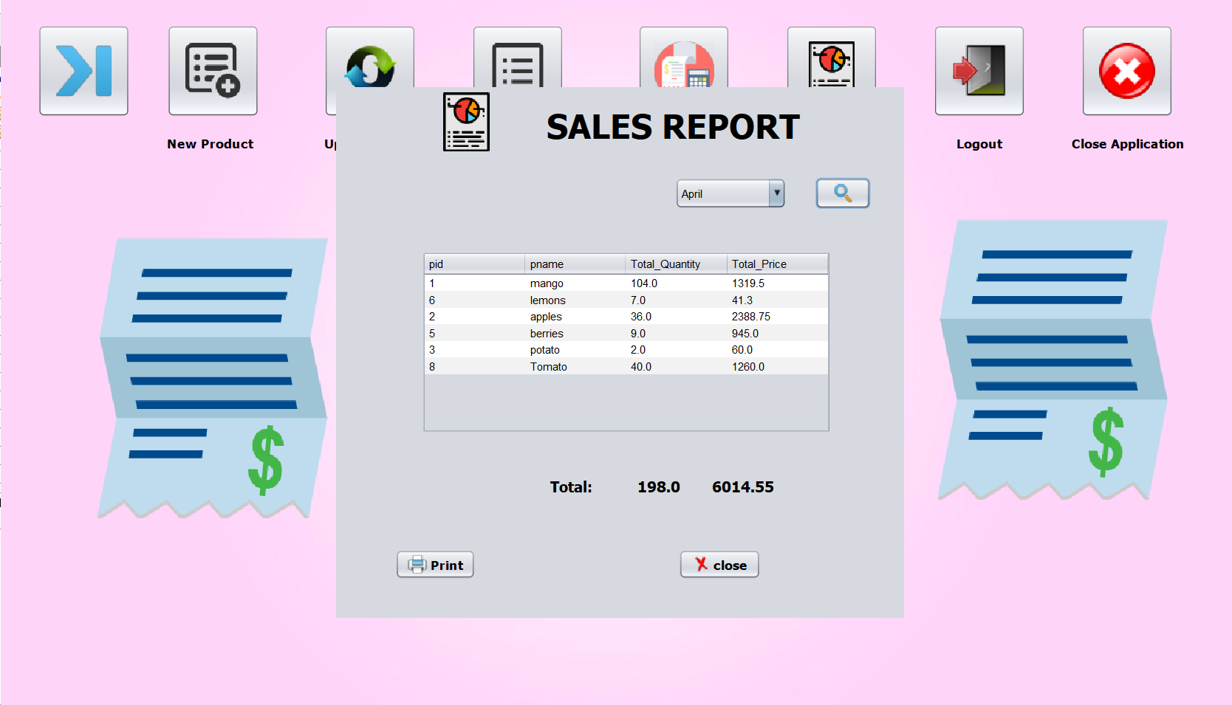

Slide 23
Thank You

